Slide 1
Plugging In
Connecting with your Membership On Line

Slide 2
Agenda
What is E-Marketing?
E-Mail Marketing Services
What is Social Media

Slide 3
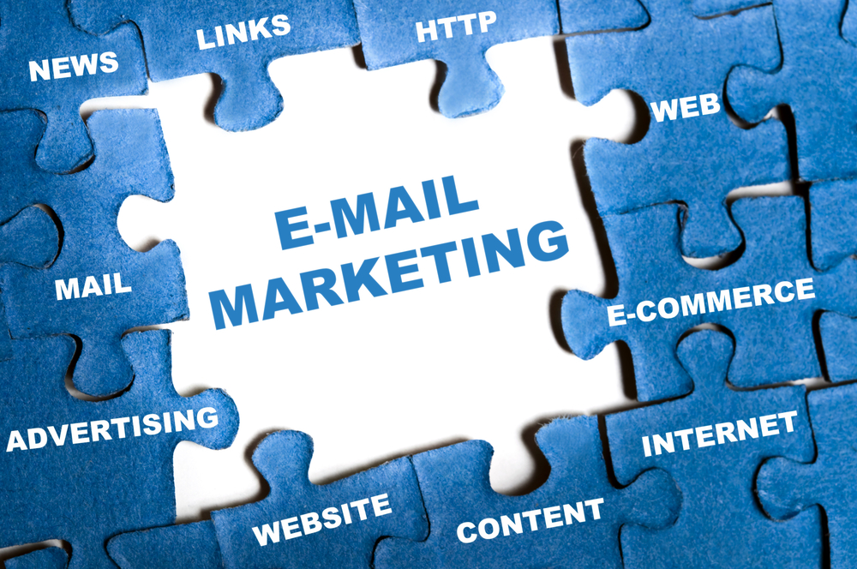
What is E-Marketing?

Slide 4
E-mail Marketing
Why e-newsletters?
E-newsletters are an effective means to drive traffic to your website, engage and inform your members and identify the needs of our community.
Your members use e-mail
Low costs
Revenue generation
Member retention
Notes:
Caution must be used with how much e-mail you send out to your members. Make sure that what you send out is relevant, necessary and timely. Sending out too much e-mail may result in the fast delete syndrome!!

Slide 5
E-mail Marketing
Services
Easy to use
Import e-mail lists
Select templates
Up to 2,000 subscribers
Up to 12,000 emails / mo.
The top 10 email marketing services
Notes:
Other resources
Constant Contact
iContact
Benchmark
Campaigner
www.Creativebeacon.com/the-top-10-email-marketing-services
MailChimp - If you have fewer than 2,000 subscribers, you can send up to 12,000 emails per month absolutely free. No expiring trial, contract, or credit card required.
Upgrade for as little as $10/month
A few of the features are only available with paid accounts. Get add-ons like autoresponders, email client testing, delivery by time zone, and Social Pro when you upgrade to a paid account.
Aweber offers a lot of the same functions as other email marketing services. The only difference that I can really see is that you have to pay $1 to get started. They don’t have a free plan, but you can send 500 subscribers unlimited emails. You can pay Monthly, Quarterly, and Yearly. They do seem to have a more designer-friendly signup form builder to integrate into your site, making your signup form more attractive. You can also animate your signup form, or even use different signup forms for different purposes.
Constant Contact offers a 60-day free trial, letting you try their service before you buy. They not only have email marketing plans and capabilities, but they also show you how to market events as well. Constant Contact also has social media integrations and campaigns as well. They also have the abilities to help you build online surveys, so that you can learn more about your customers and how they feel about your services. After the trial, their pricing plans are reasonable, and scale well with the number of subscribers that you have.

Slide 6
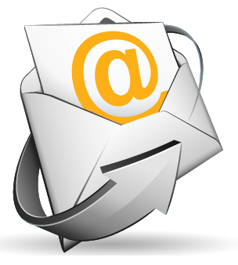
E-mail Marketing
Tips
Subject line is KEY!
Make it Useful.
Make it Interesting.
Keep it Simple.
Link to Website.
Notes:
If you’re a local business who wants to improve the quality of your emails, check out these seven email marketing tips. They’ll help you to create flawless emails that not only look and sound great but also work to convert more of your leads into customers and help you to retain more existing customers.
1. Write Succinct and Compelling Subject Lines
According to a recent study, email subject lines should be about six to ten words in length. Subject lines should capture your audience’s attention and give them a reason to open the email by addressing their wants and needs. Popular subject lines are often:
· Actionable: “50% Off [New Service] — Call and Book Yours Today!”
Related Resources from B2C · Educational: “Want to Try Yoga? Check Out This Beginner’s Video”
· Local: “[Location] Neighbors: Enjoy This Buy One Get One Free Offer”
· Inclusive: “Join Us This Weekend at the [Company Name] Open House!”
· Newsworthy: “[Company Name] News Flash — [New Location] Opening Saturday”
2. Create Cohesive and Engaging Body Copy
Your email’s body copy should reflect the email subject line. After all, your readers opened the email based on the subject line; thus, a cohesive message that supports the email subject line needs to follow. (Email copy that strays from the subject line might also be construed as a “bait and switch” tactic to your readers and relegate you to their spam folder.)
When it comes to copy length, keep your message as succinct as possible but don’t exclude any vital facts your readers need to know. As with your subject line, keep the wants and needs of your audience in mind when writing body copy. How does your product or service benefit them? What does your audience have to gain by doing business with you rather than with your competitors? What is your company’s value proposition? Answering these questions can help you create dynamic messaging that helps convert more leads into customers and encourages current customers to keep doing business with you.
3. Include a Strong CTA
The body copy should conclude with a direct call to action (CTA). Effective CTAs let your readers know what their next step should be after they’ve finished reading the body copy. Some CTA examples include:
· “Request a free quote!”
· “Download your free ebook.”
· “Redeem your coupon now.”
4. Proofread Your Email Before Sending
You’ve heard that the “devil is in the details,” which is why you should always proofread your emails carefully. Something as simple as an outdated phone number, misspelled name, or a typo in your brick-and-mortar address can confuse your audience, and put you in a bad light, too!
A good editing tactic is to read your email out loud to yourself. Does it sound too wordy? Does it include relevant dates, instructions, or other important information? Do all the links, including your CTA button, open the correct web page? You should also ask a business partner or trusted employee to read the email after you’ve proofread it. A second pair of “fresh eyes” can often catch the minor mistakes and typos that you might have missed.
5. Ensure Your Emails are Professionally Designed
What does design have to do with email writing? What your email looks like is just as important — if not more so — than what it actually says. Refrain from using too many colors, outdated fonts, low-quality images, or large photos that may not download quickly. Also, make sure to add alt text to the images in your emails in case they don’t load on the page, and avoid putting all of the copy in your image. You should test your emails to make sure they’re readable on tablets and mobile phones, too.
If you lack design skills, consider using an email template like those that are available with email marketing or lead nurturing software. If you have more in-depth needs, hiring a professional graphic designer who knows email best practices can be worth the investment.
6. Be Cognizant of Audience Values
Be sensitive to the values of your audience and refrain from being offensive or controversial in your messaging. Your email content should always be related to your business and refrain from topics like politics or religion (unless you’re a political or religious organization), and other sensitive subjects.
7. Comply With the CAN-SPAM Act
Did you know that there is a federal trade law regarding email marketing? Known as the CAN-SPAM Act, this law is designed to protect consumers from deceptive email practices, such as sending emails with incorrect subject lines. Law violations can cost up to $16,000 per email, so take the time to learn what you can and cannot do in your email marketing. The Federal Trade Commission’s Bureau of Consumer Protection published a Compliance Guide for Business to help companies comply with the law. According to the guidelines, your emails need:
· Accurate header information
· Accurate subject lines
· Identification as ad
· A physical postal address
· Easy-to-find opt-out information
The law also states that as a business owner, you need to honor a recipient’s opt-out request within 10 business days. You’re also responsible for any actions that third parties make on your behalf, so make sure you’re monitoring any email marketing vendors you’ve hired. If you have any doubts about whether or not your email marketing complies with federal law, seek legal advice.
With a little time and effort, you can give your emails the polish they might need to stand out with your audience and help you to retain and close more business.
Read more at http://www.business2community.com/email-marketing/7-tips-creating-flawless-emails-business-0960839#Iq1cu9MysRA40urv.99

Slide 7
E-mail Marketing
When to send e-newsletters
Studies have shown the majority of inbox traffic and activities occur on working days – with the peak on Thursday. This is the top day for all metrics: percent sent, open rate and click through rate.

Slide 8
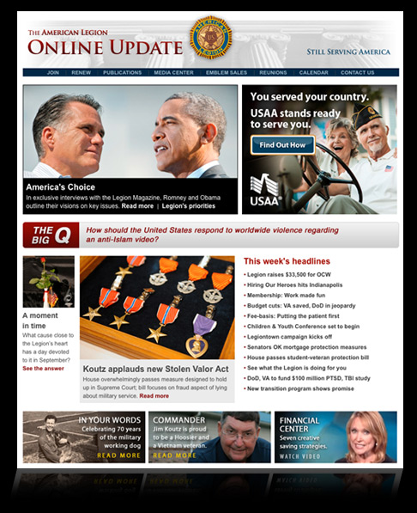
E-mail Marketing
Online Update
Weekly on Thursdays
Over 450,000 subscribers
30% Open Rate
Goto:
Online Update

Slide 9
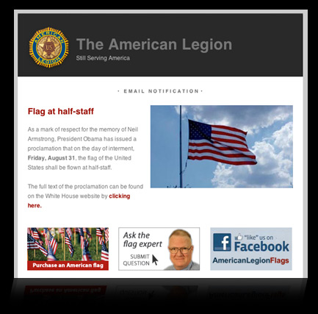
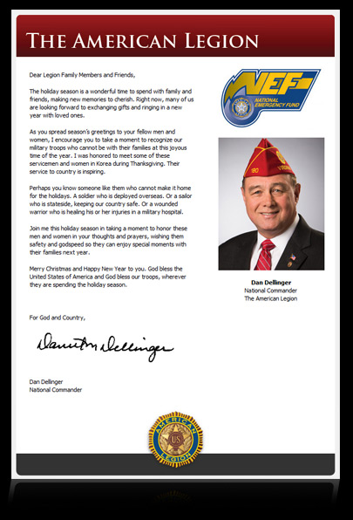
E-mail Marketing
Flag Alert
Flag at Half-Staff
Over 35,500 subscribers
Commander’s Message
~ Quarterly
Over 450,000 subscribers
Notes:
Click on any of the images and it will take you to the National American Legion Site page for all of their e-newsletters.

Slide 11
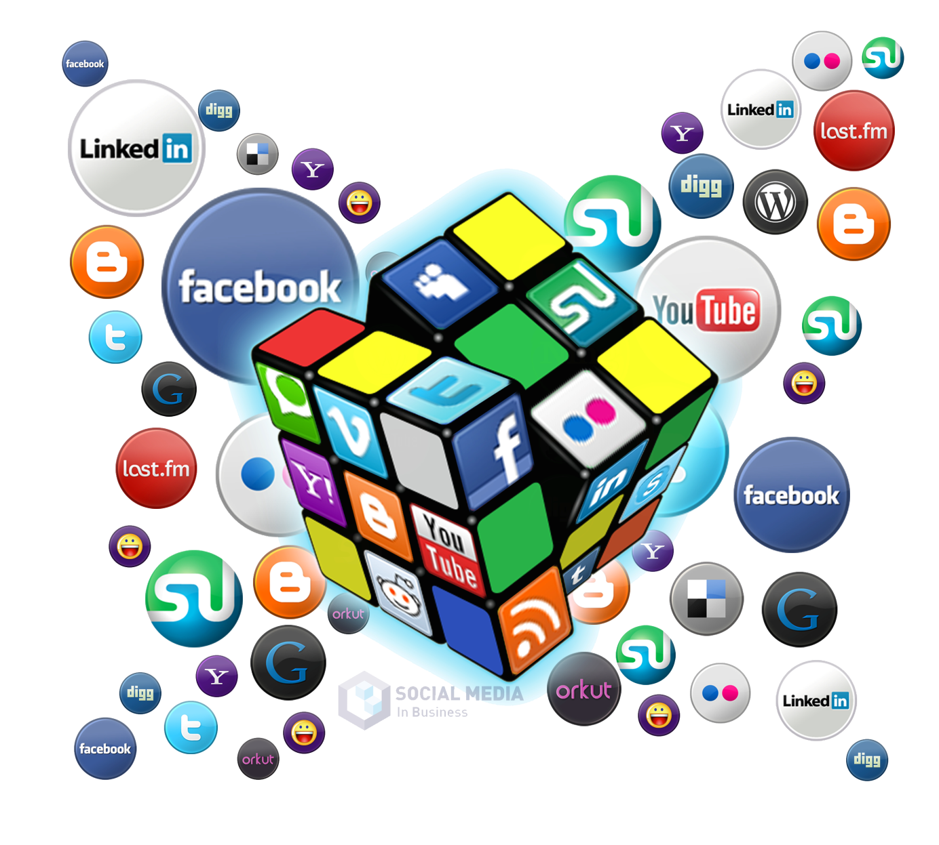
What is Social Media?

Slide 12
Social Media
Online interactions with eligible non-members can become conversations and your best recruiting tool.
Listen and respond
Understand your goals and audience
Decide on platform(s) and use them
Be professional, but be yourself
Execute
Notes:
Social media is work. It requires commitment and cannot be left alone, because if left alone, it too will be left alone.

Slide 13
Social Media
Participation - encourages contributions from everyone blurring the line between media and audience.
Openness - encourages voting, comments and sharing of information.
Conversation - allows you to engage in an exchange of ideas and opinions.

Slide 14
Social Media
Community - joins you with other people who share common interests, such as photography, a political issue or a favorite television show.
Connectedness - is what most types of social media thrive on, making use of links to other sites, resources and people.

Slide 15
Social Media
Types of social media
Blogs - are articles with a personality behind them.
Microblogging - is social networking with bite-sized blogging.
Social networks - allow you to connect with friends.
Forums - are for online discussion, often around specific interests.
Notes:
If interested in blogging, I would suggest visiting www.wordpress.com
Microblogging is nothing more than Twitter

Slide 16
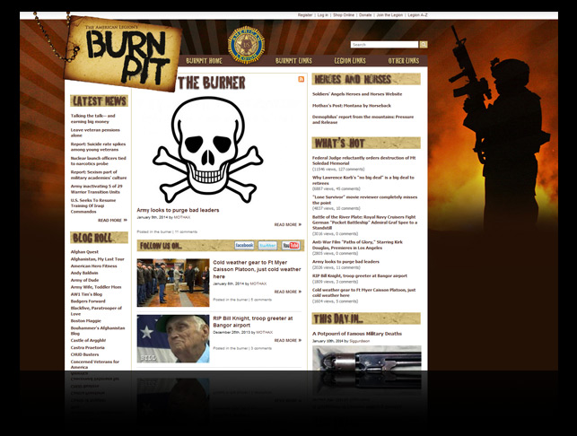
Social Media
The Burn Pit
Mark Seavey
Loyal Community
Calls to Action
Fundraising
The Burn Pit
Notes:
This is probably the best example of a blog for veterans and legionnaires.

Slide 17
Social Media
Microblogging
Twitter
An online service that allows users to send and read “tweets”, which are messages limited to 140 characters.
Notes:
Connect your Twitter account to your Facebook account so that when your tweet something it will show up on your Facebook page as well and vice versa.
Some Twitter terms
Followers - are the people who have signed up to see tweets from you in their feed. People can follow you and you can follow others.
Re-tweeting - is the act of forwarding another person’s tweet to all of your followers.
Trending topic - is a subject algorithmically determined to be among the most popular on Twitter at the moment.
Hashtag - is the ‘#’ symbol used to mark keywords or topics in a tweet. Hashtags are used as a way to categorize messages. (#veteransbenefits)
Fill out the "bio" section.
Tweet frequently.
Follow other Twitter accounts similar to yours.
Customize your Twitter background and theme.
Advertise your Twitter account in other media.
Avoid arguments.

Slide 18
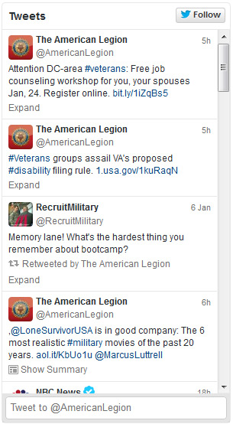
Social Media
Microblogging
Use @AmericanLegion when tweeting to target the National Headquarters account. This will allow them to see your tweet and possibly re-tweet your message.

Slide 19
Social Media
Why YouTube?
More than 1 billion unique users visit YouTube each month
Over 6 billion hours of video are watched each month
According to Nielsen, YouTube reaches more US adults ages 18-34 than any cable network
Notes:
Need some notes on the video formats and length for you tube

Slide 20
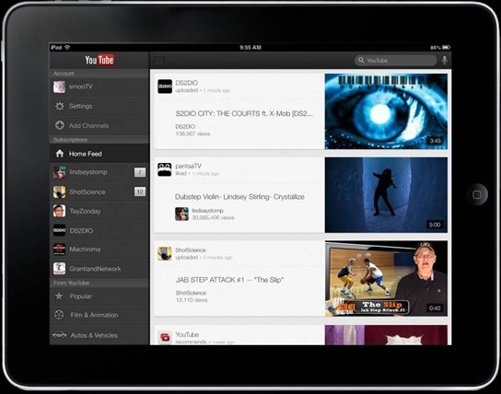
Social Media
YouTube tips
Create compelling videos.
Keep it short and to the point.
Create a searchable title.
Leverage other social media platforms.
Review analytics.

Slide 21
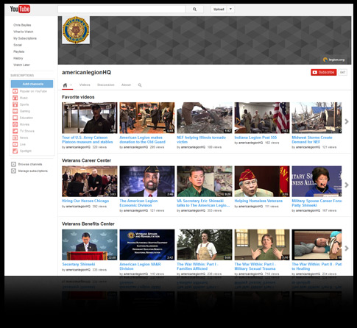
Social Media
YouTube: Our channel

Slide 22
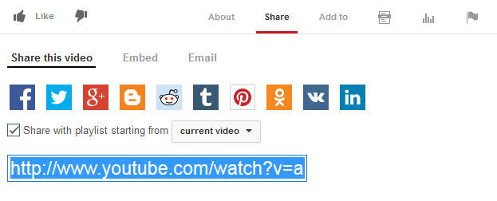
Social Media
YouTube: How to share videos

Slide 23
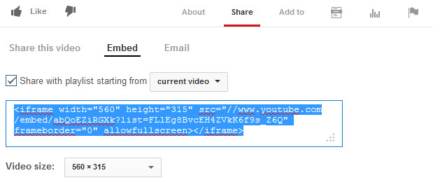
Social Media
YouTube: How to embed videos

Slide 24
Social Networks
How to use Facebook
Create an account
Build a page
Connect with members and non-members
Engage your audience
Influence your audience and their network
Facebook.com
Go to:

Slide 25
Social Networks
Facebook: Build a page
Choose a category (non-profit) and a descriptive Page name
Choose a profile image people can associate with your post
Write a sentence about your post
Set a memorable web address for your Page to advertise in print
Choose a cover photo that represents and showcases your post
Facebook.com/pages/create
Go to:

Slide 26
Social Networks
Facebook: Connect
Place a link on your website
Invite e-mail subscribers
Display a flyer at your post
Use “suggest to friends” feature
Place Facebook ads
Notes:
It is a must to connect your Facebook page and your Website. If you don’t you are missing potential members.
Advertise your Facebook page and Website with flyers in your post, at events, at community centers, veterans centers, etc.
Advertising on Facebook can be another option if you have the budget for it.
Make sure you put your Facebook and website links on all correspondence, advertisements, posters, flyers, etc. Never miss an opportunity to put it out there.

Slide 27
Social Networks
Facebook: Engage your audience
Write quality posts that are relevant to your audience
Be friendly and conversational
Share photos and videos (Be careful what you post)
Ask questions or seek input
Be timely by posting about current events, holidays or news
Ask your audience to share your posts
Notes:
Limit the number of people who can post comments and information as the Official Post contributor. (Explain admin settings)
Provide information about events, the passing of a fellow legionnaire, important news for veterans, etc.
Use people talk, don’t sugar coat things, say it like it is, keep it clean (no profanity)
Photos should be of events and people. Be careful not to have a bunch of photos of people drinking, acting foolish and so forth. You are what you post on Social Media. Facebook can be an effective tool for showing prospective members what it is we do in the community.
If you are going to use Facebook as a means of advertisement, do it in a timely manner. Don’t wait until the last minute to post things. The more time folks get to see it on your page, the more chances are they will help you spread the word. You can also create calendar events for your organization on Facebook and send an invite to all of your members who have liked your page.
Let your audience help you by sending in posts.

Slide 28
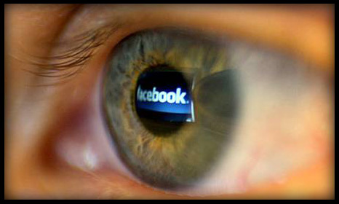
Social Networks
Facebook: Influence
When people “like”, comment” or “share” your content on Facebook, their friends are notified in their news feeds. The more people interacting with your content the better.
Facebook.com/pages/create
Go to:
Notes:
The number one goal is to get all of your members to like your page. Therefore, when they like one of your posts, all of their contacts and friends will see it. And if they like it, all of their friends will see it, and so on, and so on, and so on.
One post I put out with a quote from Gen. Norman Schwarzcopf garnered more than 300,000 likes in two days, all because of the reach of Facebook friend influence and sharing the post.

Slide 29
Social Networks
Facebook tips
Post at least once a week
Vary your content: events, photos, honor & remembrance
Be friendly and conversational
Provide calls to action
Make it “sharable”
Provide exclusive content they cannot find in other media
Notes:
Don’t just post things and think your job is done. Facebook is an interactive community and if you do not routinely look at your posts to see who is commenting and provide comments back to those people, they will soon stop commenting and possibly stop liking your page.
Respond to comments, even the negative ones. Do it professionally. If a comment is offensive, respond in a professional manner and ask that those types of comments be kept off of your site. If they continue, tell them they are in jeopardy of being blocked from posting.

Slide 30
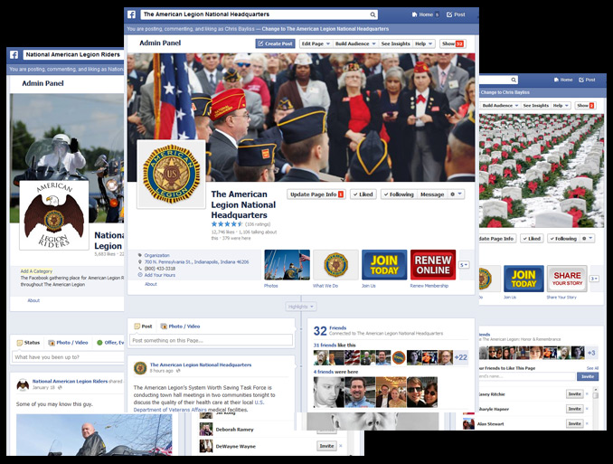
Social Networks
A look at our Facebook pages
National Headquarters
Online Update
Legion Riders
Legion Baseball
Honor & Remembrance
National Convention
Legion.org/facebook
Go to:

Slide 31
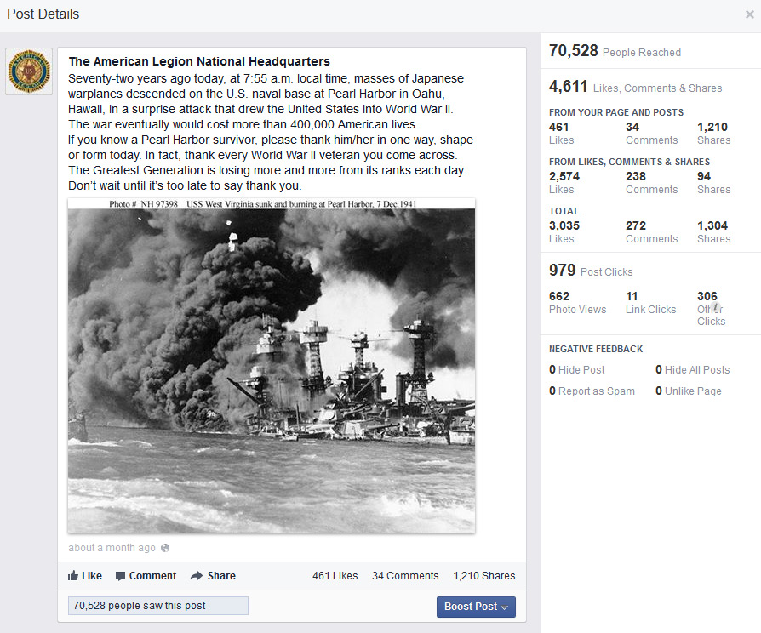
Social Networks
A look at successful Facebook post from National
Notes:
National Headquarters has a little more than 13,000 likes, yet this post was seen by more than 70,000 people. That shows the power of the Social Network.

Slide 32
Social Networks
Other social media worth mention
LinkedIn
Google+
Pinterest
Notes:
Linkedin is a social networking website for people in professional occupations. Founded in December 2002 and launched on May 5, 2003, it is mainly used for professional networking. In 2006, LinkedIn increased to 20 million viewers.
Google+ is a social networking and identity service that is owned and operated by Google Inc. Google has described Google+ as a "social layer" that enhances many of its online properties, and that it is not simply a social networking website, but also an authorship tool that associates web-content directly with its owner/author. It is the second-largest social networking site in the world after Facebook.
Pinterest is a visual discovery tool that people use to collect ideas for their different projects and interests. People create and share collections (called “boards”) of visual bookmarks (called “Pins”) that they use to do things like plan trips and projects, organize events or save articles and recipes.

Slide 33
myLegion.org
MyLegion.org is designed to connect members of The American Legion to their Post and Department leadership.
Membership information - view member renewals
Data change forms
Consolidated Post Reports
Search for expired members
MyLegion.org
Go to:

